Slide 1
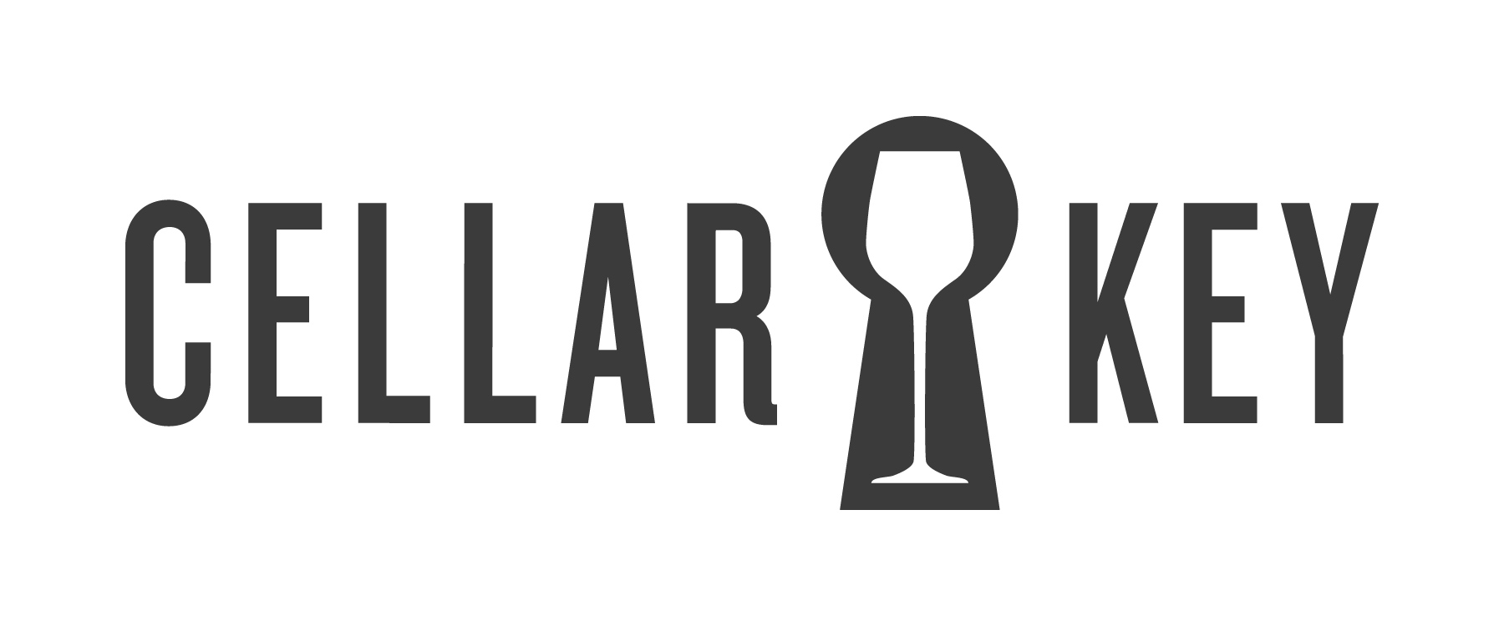
Sonoma Coast
Sonoma Coast
2011Pinot Noir
2011Pinot Noir
“Spicy and pretty….”
“Medium ruby color; light spice and cherry aromas; ripe, cherry and spice flavors with some earthy notes; silky texture; good structure and balance; long finish. Spicy, pretty flavors make
this a great Pinot for
the table.”
“Spicy and pretty….”
“Medium ruby color; light spice and cherry aromas; ripe, cherry and spice flavors with some earthy notes; silky texture; good structure and balance; long finish. Spicy, pretty flavors make
this a great Pinot for
the table.”
91
91
points
points
“Smart Buy”
PinotReport
Scan and explore.
Visit getcellarkey.com on your smartphone
“Smart Buy”
PinotReport
Scan and explore.
Visit getcellarkey.com on your smartphone
Sonoma Coast
Sonoma Coast
2011Pinot Noir
2011Pinot Noir
“Spicy and pretty….”
“Medium ruby color; light spice and cherry aromas; ripe, cherry and spice flavors with some earthy notes; silky texture; good structure and balance; long finish. Spicy, pretty flavors make
this a great Pinot for
the table.”
“Spicy and pretty….”
“Medium ruby color; light spice and cherry aromas; ripe, cherry and spice flavors with some earthy notes; silky texture; good structure and balance; long finish. Spicy, pretty flavors make
this a great Pinot for
the table.”
91
91
points
points
“Smart Buy”
PinotReport
Scan and explore.
Visit getcellarkey.com on your smartphone
“Smart Buy”
PinotReport
Scan and explore.
Visit getcellarkey.com on your smartphone

