Slide 1
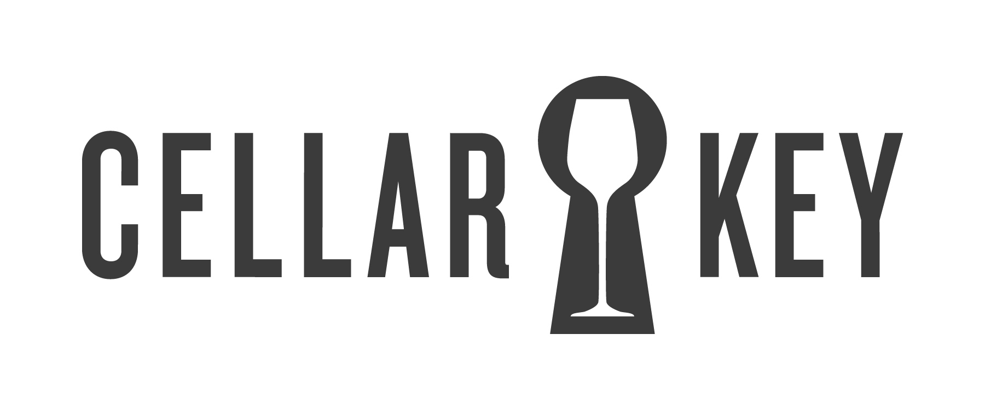
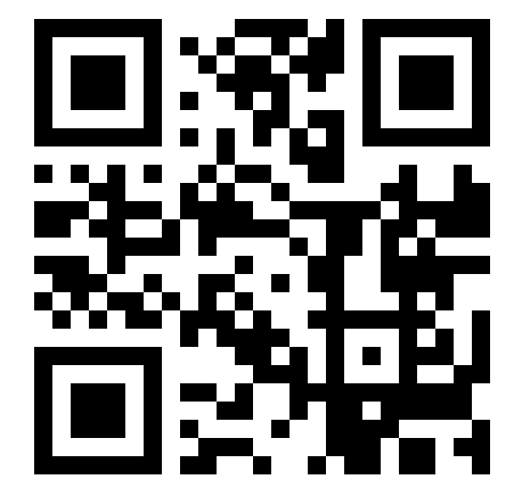
Sonoma Coast
Sonoma Coast
2012Chardonnay
2012Chardonnay
“So bright and zingy in acidity, and so ripe in tangerine, mango, lime fruit and honeysuckle, that you hardly notice the oak influence. Yet, it’s there in the form of buttered toast. The result is a big, powerful Chardonnay,
clean and vibrant, for
drinking now….” - S.H.
“So bright and zingy in acidity, and so ripe in tangerine, mango, lime fruit and honeysuckle, that you hardly notice the oak influence. Yet, it’s there in the form of buttered toast. The result is a big, powerful Chardonnay,
clean and vibrant, for
drinking now….” - S.H.
90
90
points
points
“Editor’s Choice”
WINE ENTHUSIAST
Scan and explore.
Visit getcellarkey.com on your smartphone
“Editor’s Choice”
WINE ENTHUSIAST
Scan and explore.
Visit getcellarkey.com on your smartphone
Sonoma Coast
Sonoma Coast
2012Chardonnay
2012Chardonnay
“So bright and zingy in acidity, and so ripe in tangerine, mango, lime fruit and honeysuckle, that you hardly notice the oak influence. Yet, it’s there in the form of buttered toast. The result is a big, powerful Chardonnay,
clean and vibrant, for
drinking now….” - S.H.
“So bright and zingy in acidity, and so ripe in tangerine, mango, lime fruit and honeysuckle, that you hardly notice the oak influence. Yet, it’s there in the form of buttered toast. The result is a big, powerful Chardonnay,
clean and vibrant, for
drinking now….” - S.H.
90
90
points
points
“Editor’s Choice”
WINE ENTHUSIAST
Scan and explore.
Visit getcellarkey.com on your smartphone
“Editor’s Choice”
WINE ENTHUSIAST
Scan and explore.
Visit getcellarkey.com on your smartphone

